Slide 1
Animal Adaptations
©2023 Waterbear Publishing
Notes:
Teacher- Begin by making a copy of the slideshow

Slide 2
What are Adaptations?
Adaptations are parts of animals or ways they behave that help them survive in their environment.
Where an animal lives!
©2023 Waterbear Publishing

Slide 3
Types of Adaptation
Physical
Adaptation
Behavioral
Adaptation
©2023 Waterbear Publishing

Slide 4
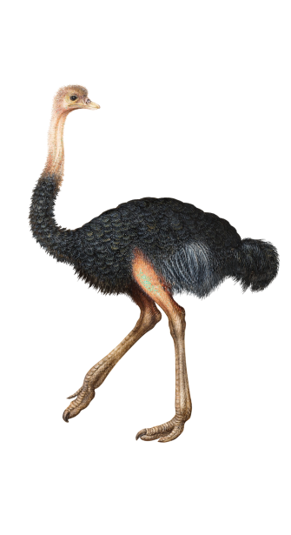
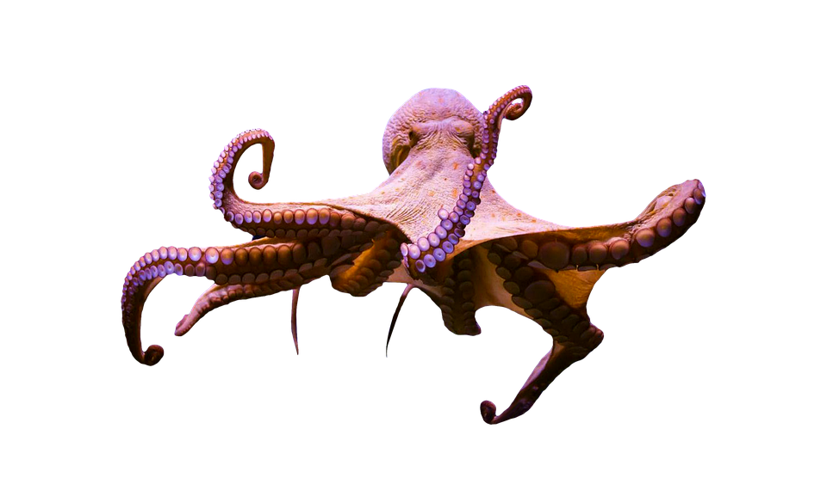
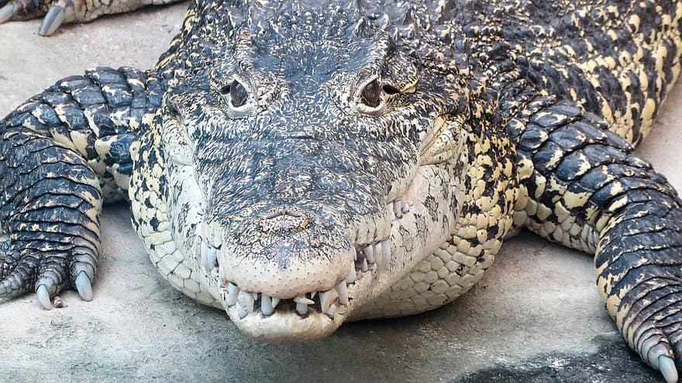
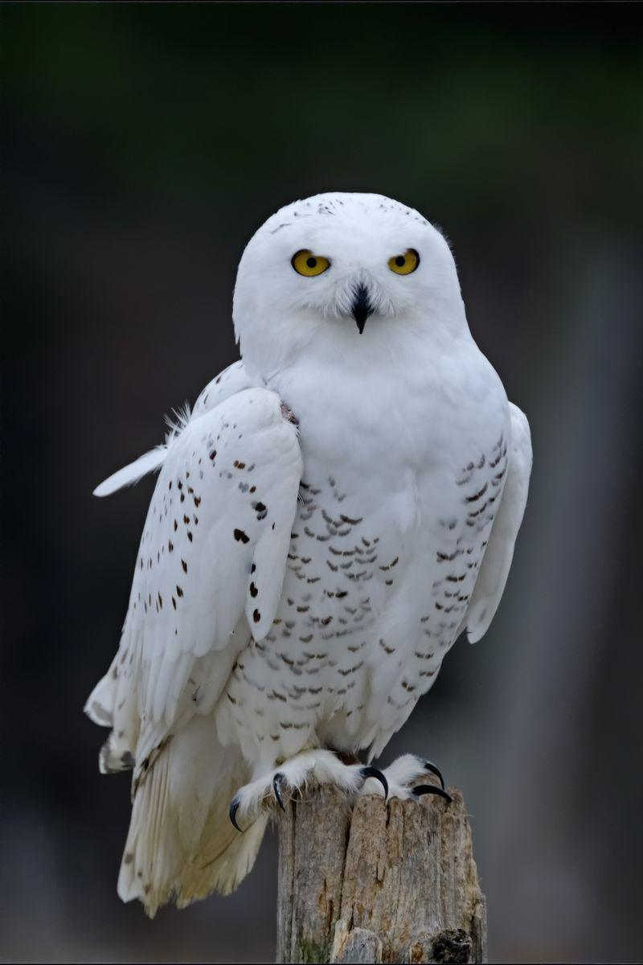
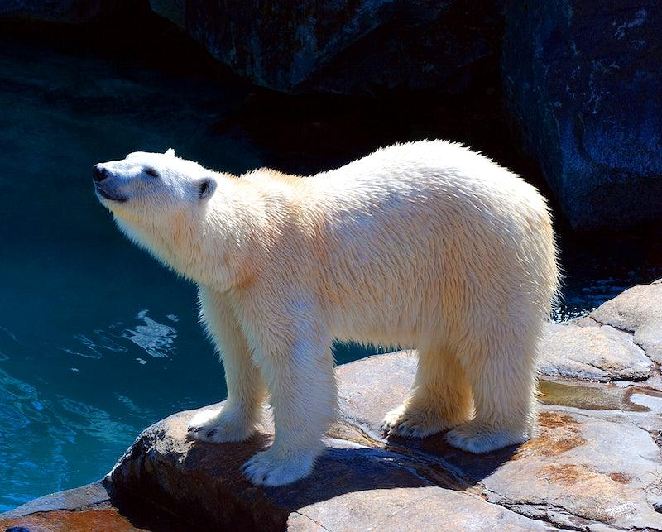
Physical Adaptation
Types of Legs
Types of Mouths/Beaks
Camouflage
Kinds of Eyes
Body Coverings
Image Credits iStock.com/JohnCarnemolla,
Carol Gray,USO,wademcmillan,T.Holman
©2023 Waterbear Publishing
Notes:
Teacher- talk about how these animals may use this body part to help them survive.

Slide 5
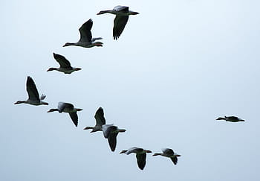
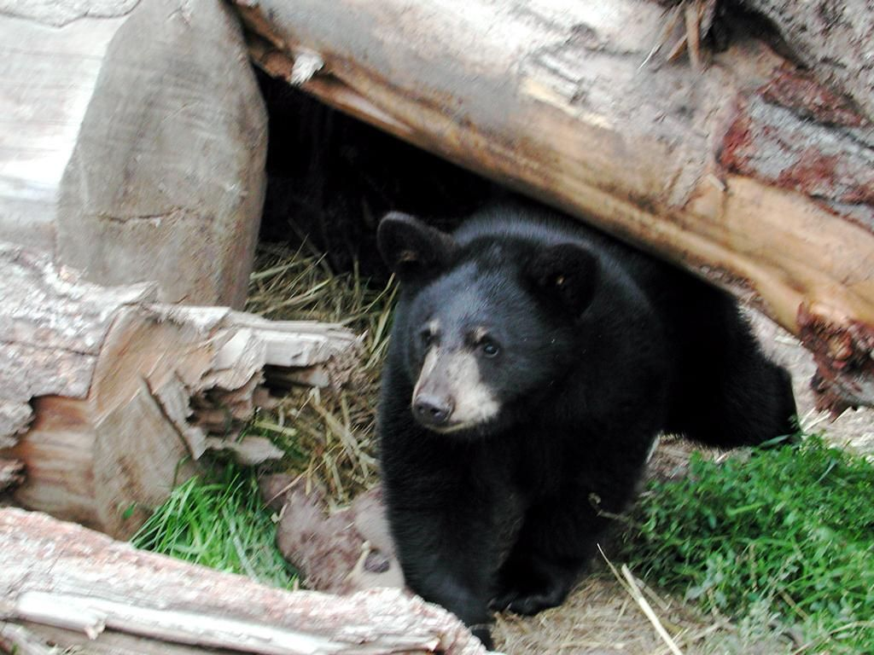
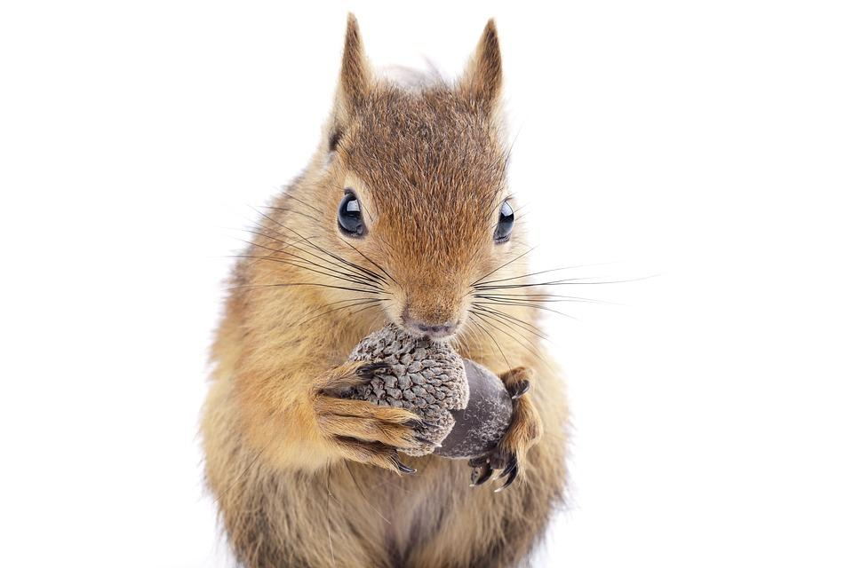
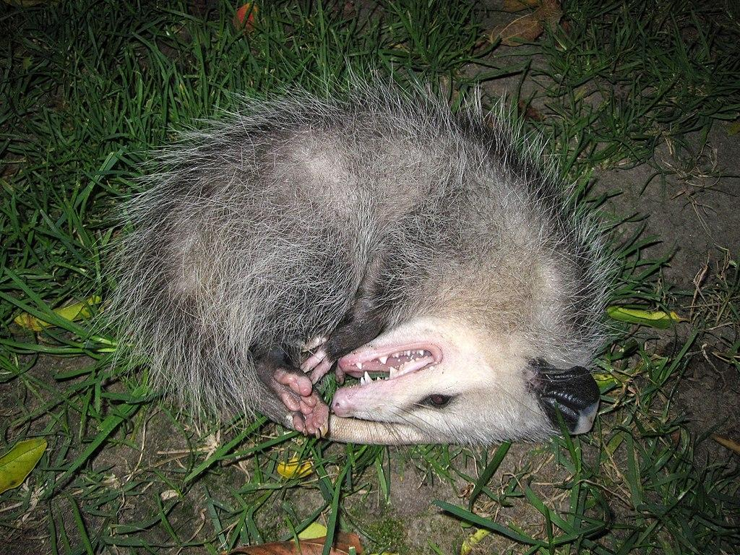
Behavioral Adaptation
Migration
Hibernation
Playing Dead
Storing Food
Image Credits iStock.com/csm07, mirceax, Miraswonderland,Songayenovell
©2023 Waterbear Publishing

Slide 6
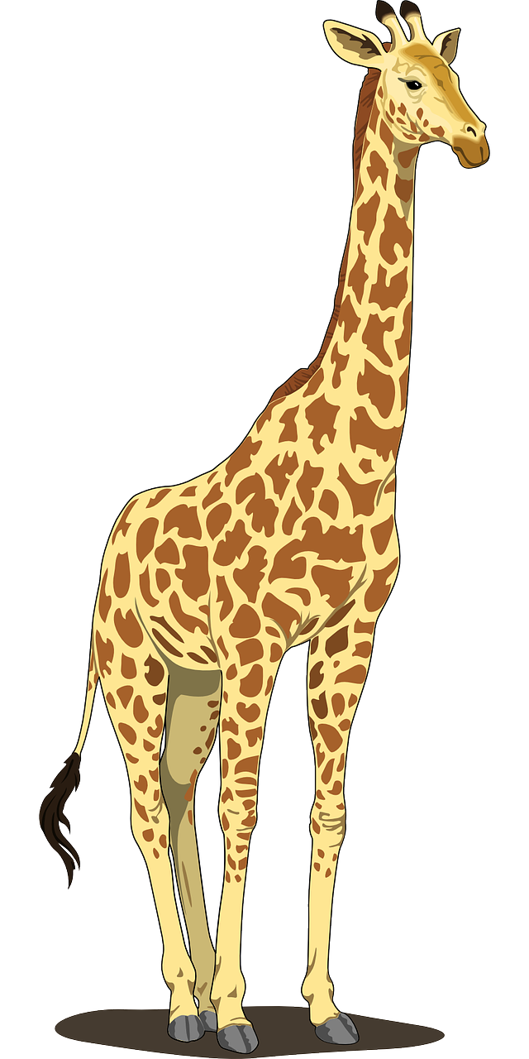
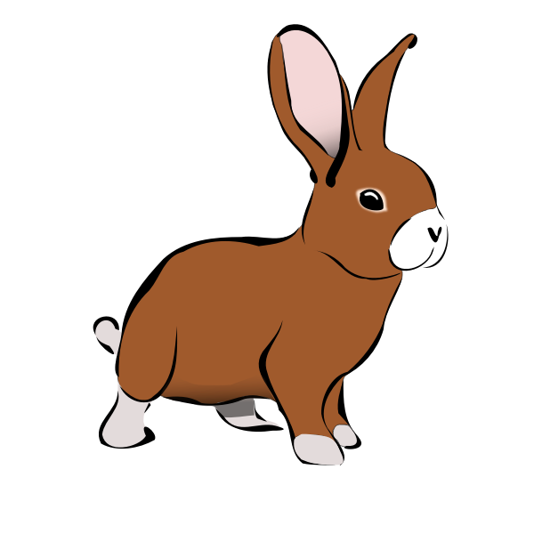
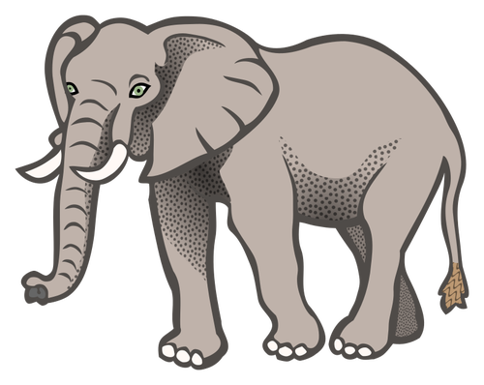
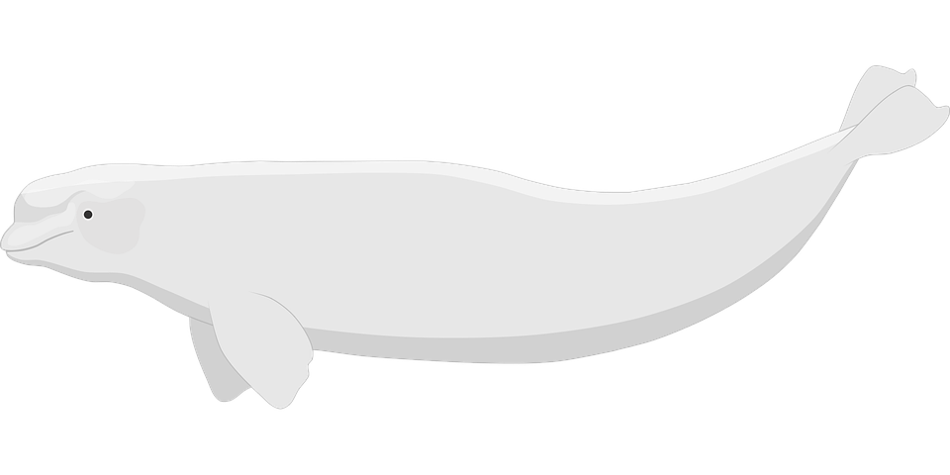
We meet many different animals in Dr. Rosie Helps the Animals.
What adaptations do they have that help them survive?
©2023 Waterbear Publishing

Slide 7
Question Time
Why is it important for Rosie to heal each of the animals in the book? What would happen if Rosie wasn’t there to help them?
©2023 Waterbear Publishing

Slide 8
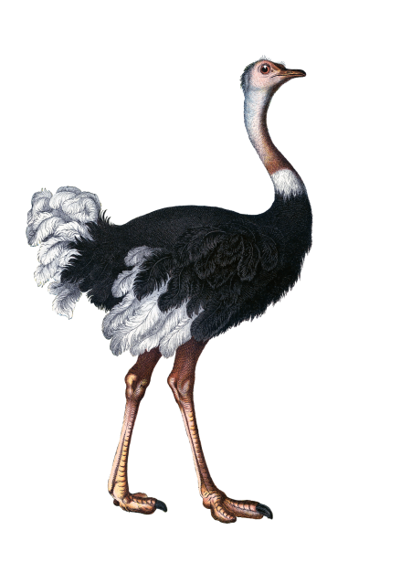
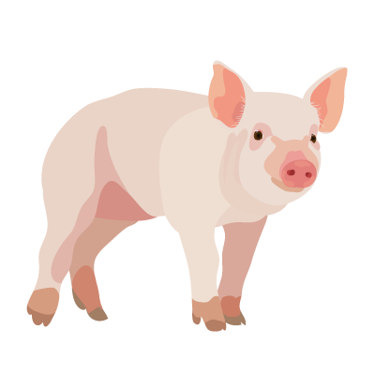
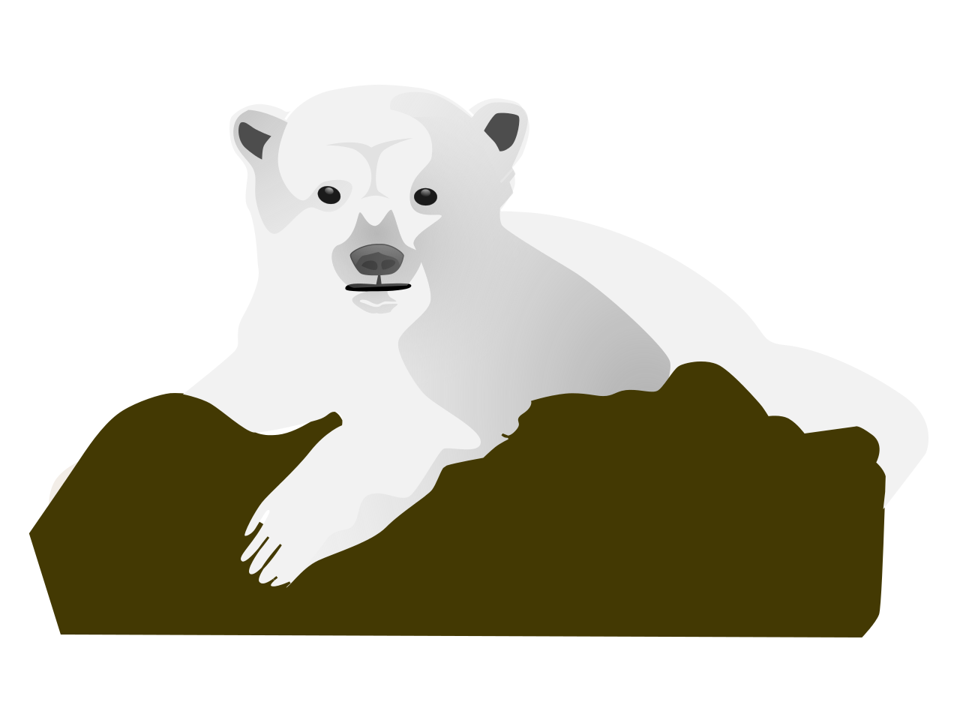
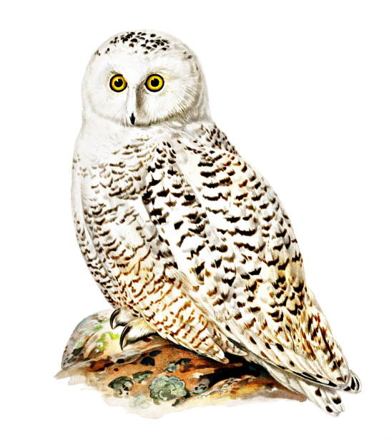
Animal from Dr. Rosie Helps the Animals | Adaptation (Structure) | Why is it important for Dr. Rosie to heal this adaptation? [What does the adaptation do (function) that helps survival?]
Rabbit | Large Ears
Pig | Big Belly
Giraffe | Long Neck
Elephant | Trunk
Ostrich | Long Legs
Crocodile | Mouth with sharp teeth
Octopus | Large head
Beluga Whale | Skin
Polar Bear | Fever (helps kill germs)
Snowy Owl | Large, front facing eyes/Night Vision
©2023 Waterbear Publishing
Notes:
Teacher- fill in part #3
Rabbit's ears need to be healthy because they need to hear predators (safety)
Pig needs to heal from an upset stomach so that it can eat again. (food)
Giraffe needs to have a healthy throat to eat (food)
Elephant needs to have an unstuffy trunk (there are a lot of things it needs a healthy trunk for)
Ostrich--legs need to be healthy to run (safety)
Crocodile-- mouth needs to not be sore so it can eat? (food)
Octopus-- head needs to be healed so it can swim fast (pushes water out like jet propulsion) to escape (safety)
Beluga -- skin needs to be healthy because it protects the body (this is challenging)
Polar bear-- needs to not have a fever so it has more energy to get food (challenging again)
Owl-- needs to have healthy eyes so it can see to get food

Slide 9
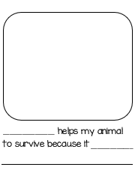
Let's Try!
©2023 Waterbear Publishing

